Slide 1


Chirped Fiber Bragg Grating
Reporter : Hao Zhang
2022-11-2

Slide 2

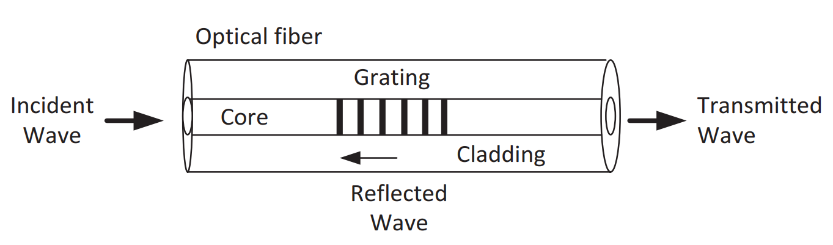
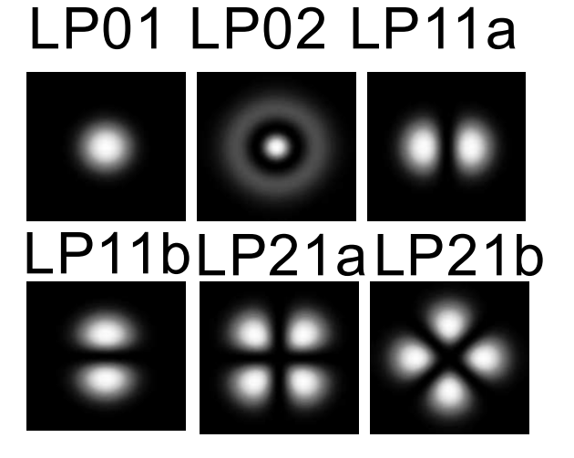
Chirped Fiber Bragg Grating
High-Bit-Rate communication system
◎ Figure 1. SMF (Single Mode Fiber)
What if we want to filter out certain wavelengths?
What if we want to compensate the dispersion of SMF?

Slide 3
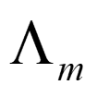

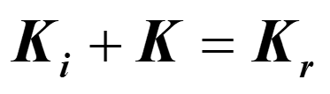
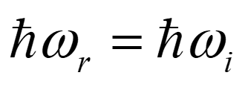
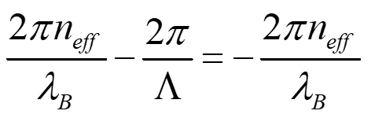
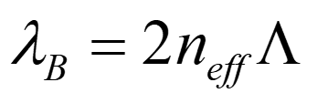
Chirped Fiber Bragg Grating
SMF
◎ Figure 2. CFBG (Chirped Fiber Bragg Grating)
a. Energy Conservation
b. Momentum Conservation
Bragg Condition
H. K. Hisham, Fiber Bragg Grating Sensors: Development and Applications. CRC Press, 2019.

Slide 4






Chirped Fiber Bragg Grating
(a)
…
pulse
broadened
Different velocity -- -- -- Different time delay
(b)
…
broadened
pulse
Recompress or restore
◎ Figure 3. Principle of Chirped Fiber Bragg Grating

Slide 5
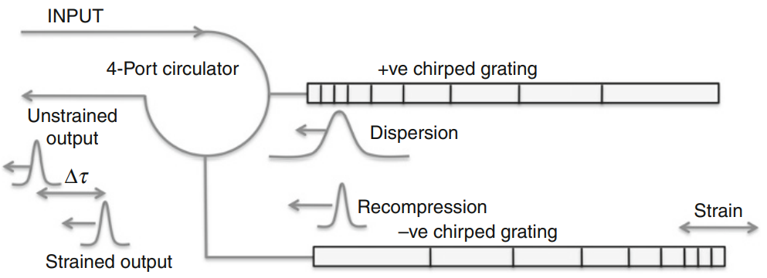
Application: Optical Delay Line
1- Disperses the pulse
2- Recompresses the pulse
Stretched
◎ Figure 4. Schematic of a twin chirped grating delay line.
[1] H. K. Hisham, Fiber Bragg Grating Sensors: Development and Applications. CRC Press, 2019.
[2] Raman Kashyap, Fiber Bragg Gratings (OPTICS AND PHOTONICS). Academic Press, 2010.

Slide 6
Thanks for your listening!
Chirped Fiber Bragg Grating
Reporter : Hao Zhang
2022-11-2

Slide 7
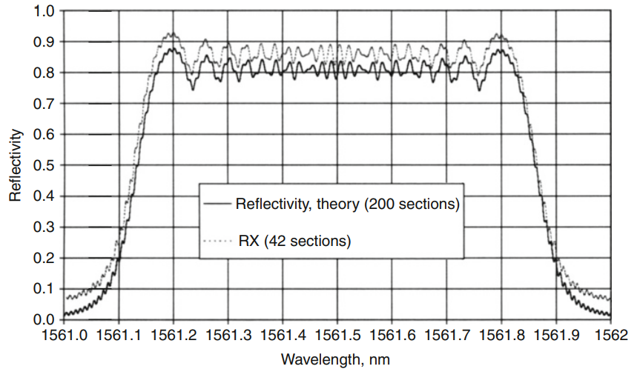
Chirped Fiber Bragg Grating
Chirped Bragg Condition
Chirped Bandwidth
◎ Figure 5. Reflectivity of a 100-mm-long Step Chirped Grating(SCG) with 200 sections as well as 42 sections.

Slide 8
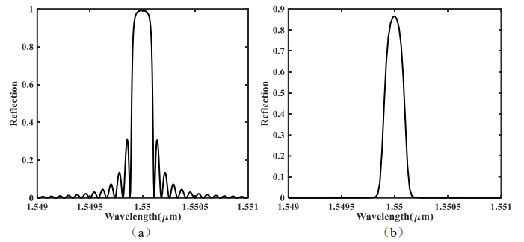
Chirped Fiber Bragg Grating
[1] Mathematical methods to extract the reflection, transmission, and group delay response:
(a) Transfer matrix method (TMW)
(b) Inverse scattering method
(c) Numerical integration Coupled-Mode equations
[2] Sidelobe effect
Effect of Apodization
◎ Figure 5. Reflectivity of a 100-mm-long Step Chirped Grating(SCG) with 200 sections as well as 42 sections.

